Slide 1

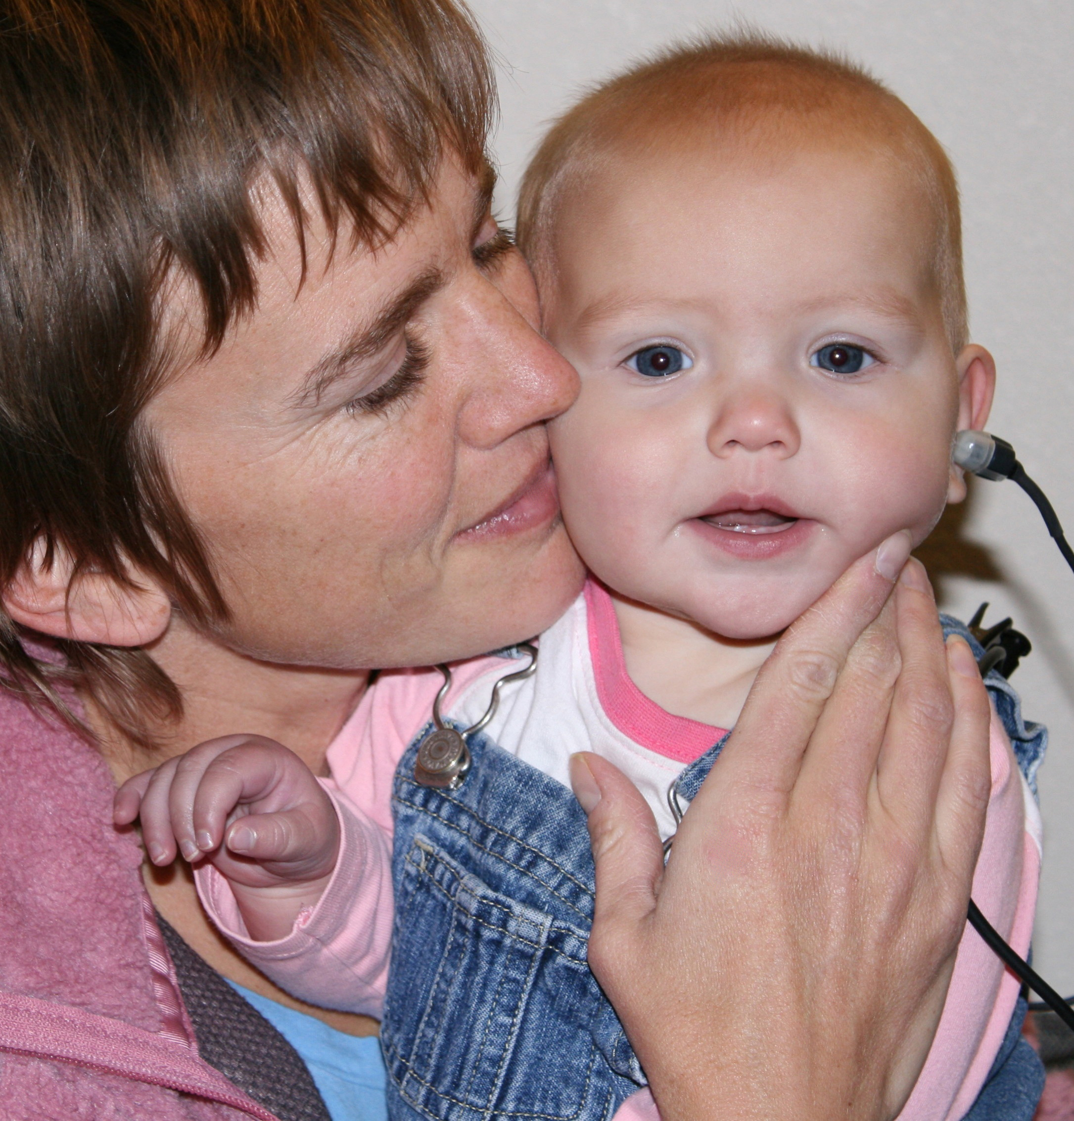

Identification of Late-Onset hearing loss in Children
Serving Early Head Start Programs as the National Resource Center on Early Hearing Detection and Intervention

Slide 2
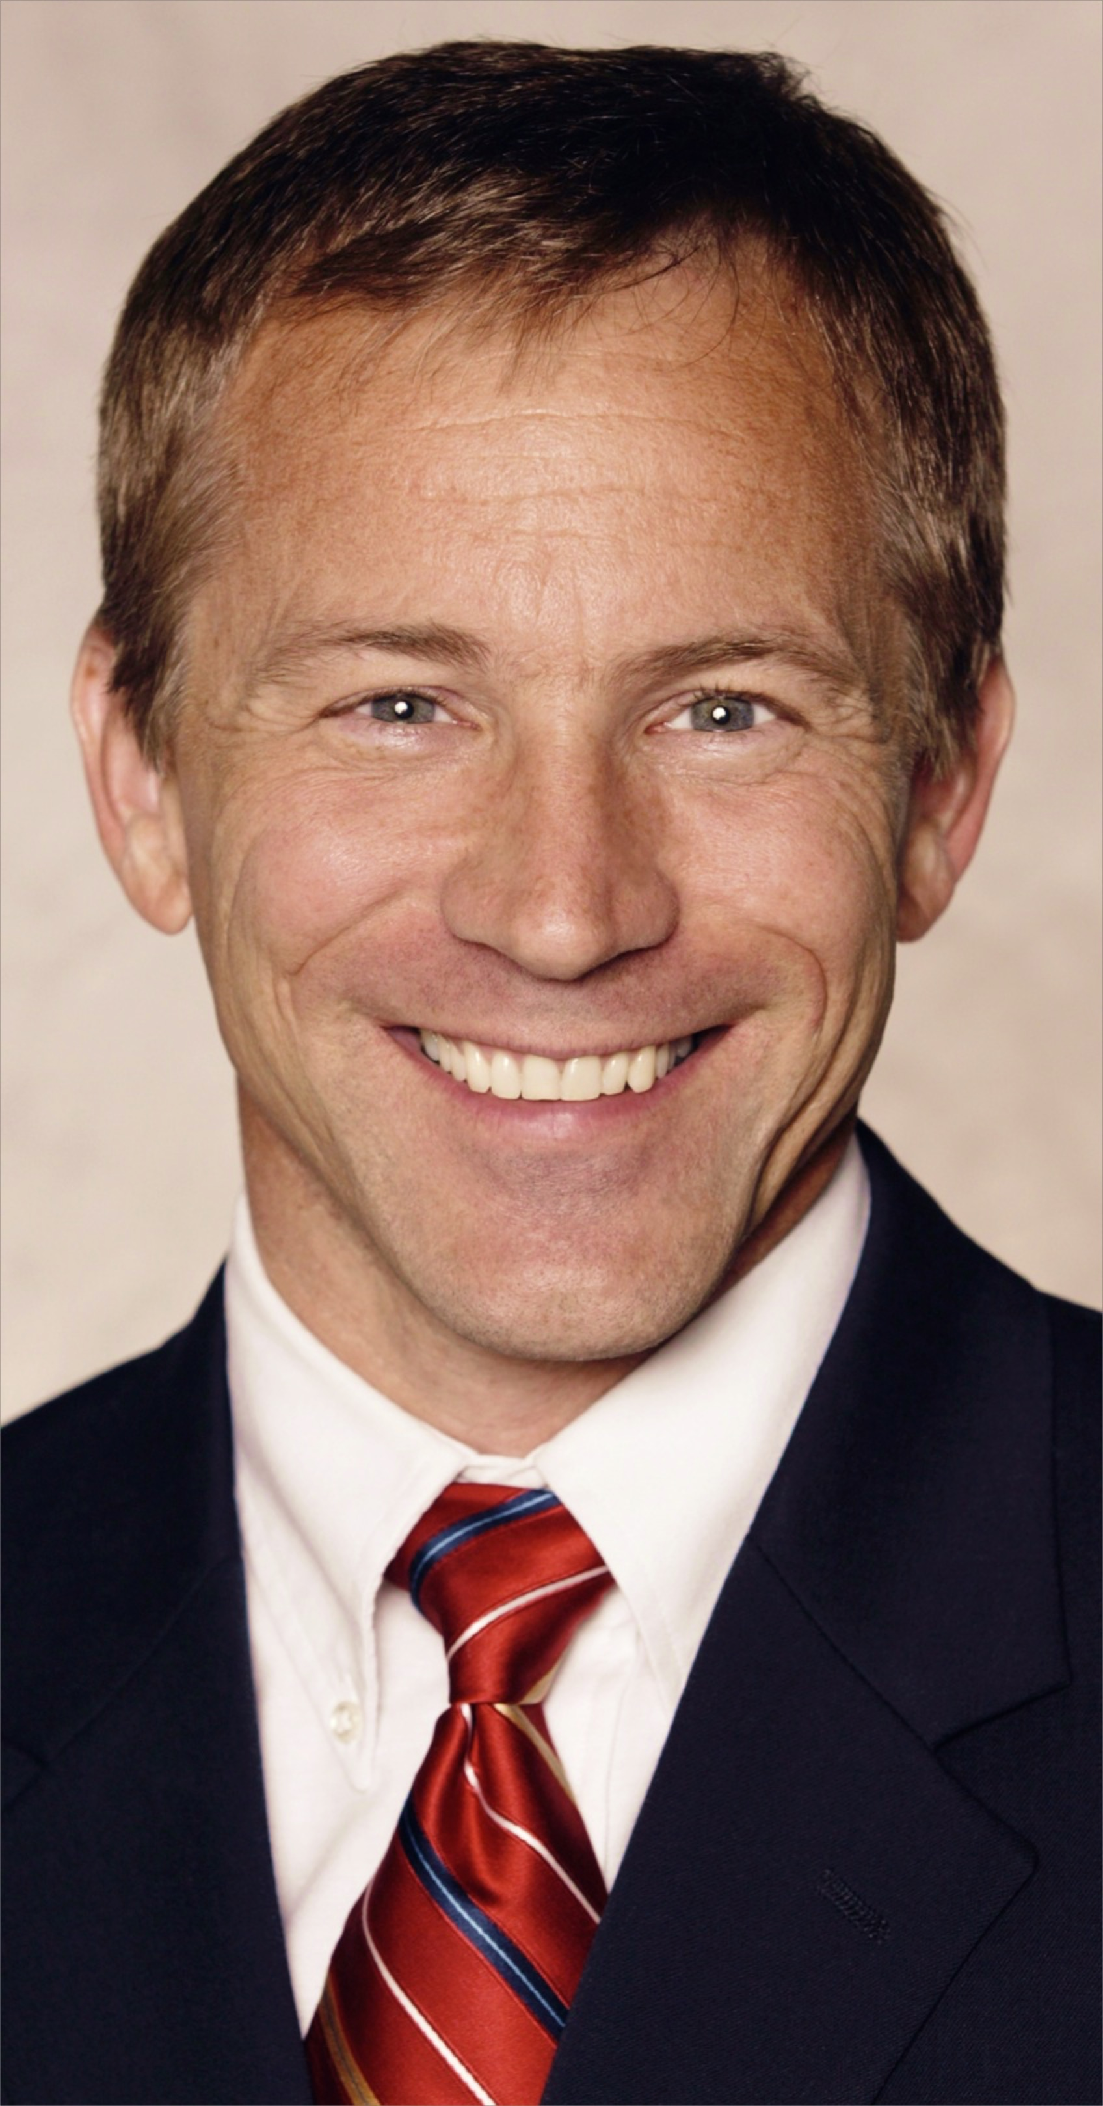
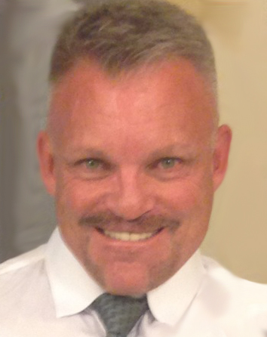


Today’s Presenters
Jeff Hoffman, MS, CCC-A
Audiologist
William Eiserman, PhD
Director
Serving Early Head Start as the National Resource Center on Early Hearing Detection and Intervention
Notes:
Before starting - go to SLIDE SHOW, select set-up show and check that advance slides manually is selected

Slide 3

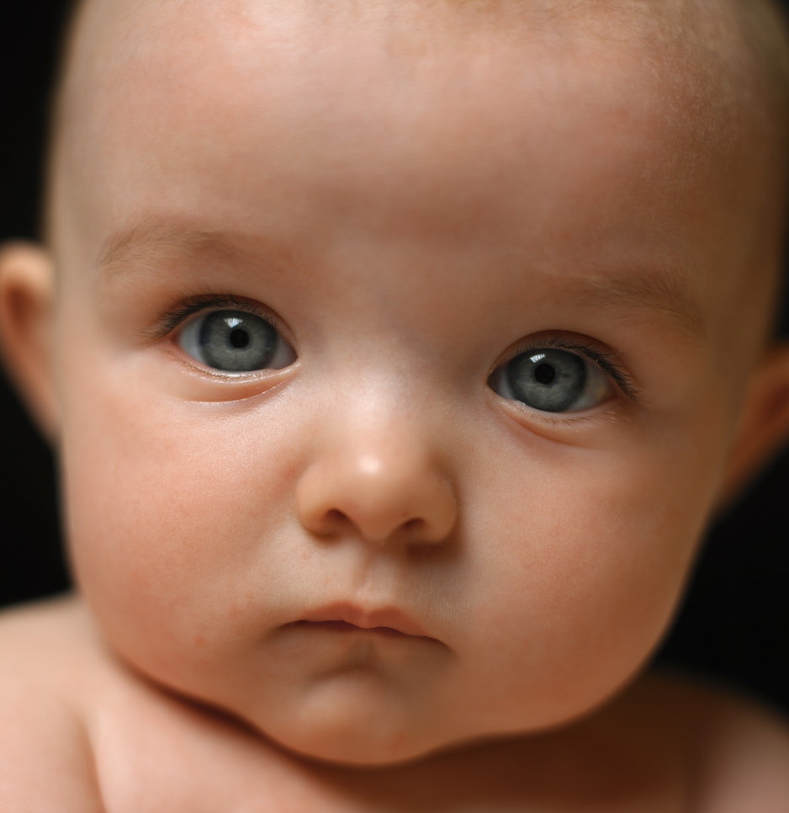
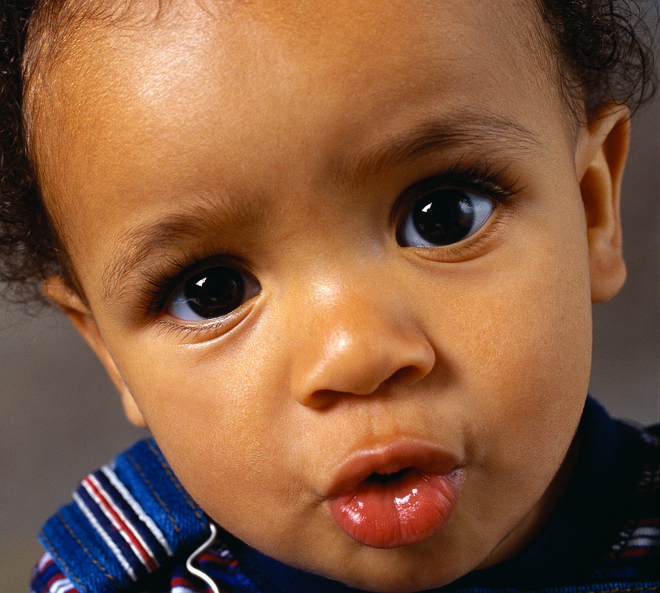
Each day, children with hearing loss attend early childhood programs...
How will we identify who they are?
Notes:
Each day, young children who are deaf or hard of hearing are being served in early childhood education and health care settings.
The question is. . .”How will we know who they are?”
Hearing loss is an invisible condition, so how can we reliably identify which children have normal hearing. . . and which may not?

Slide 4
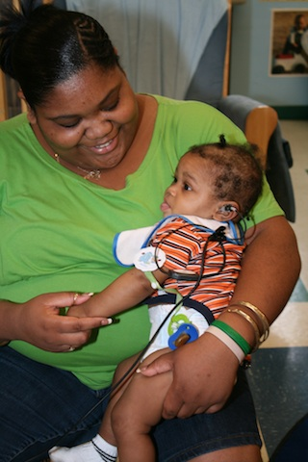
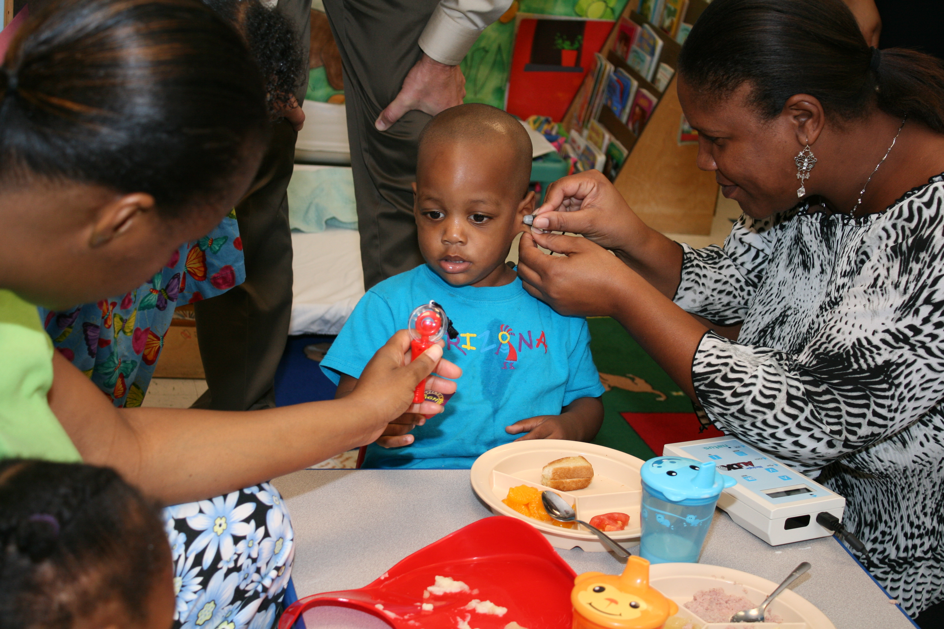
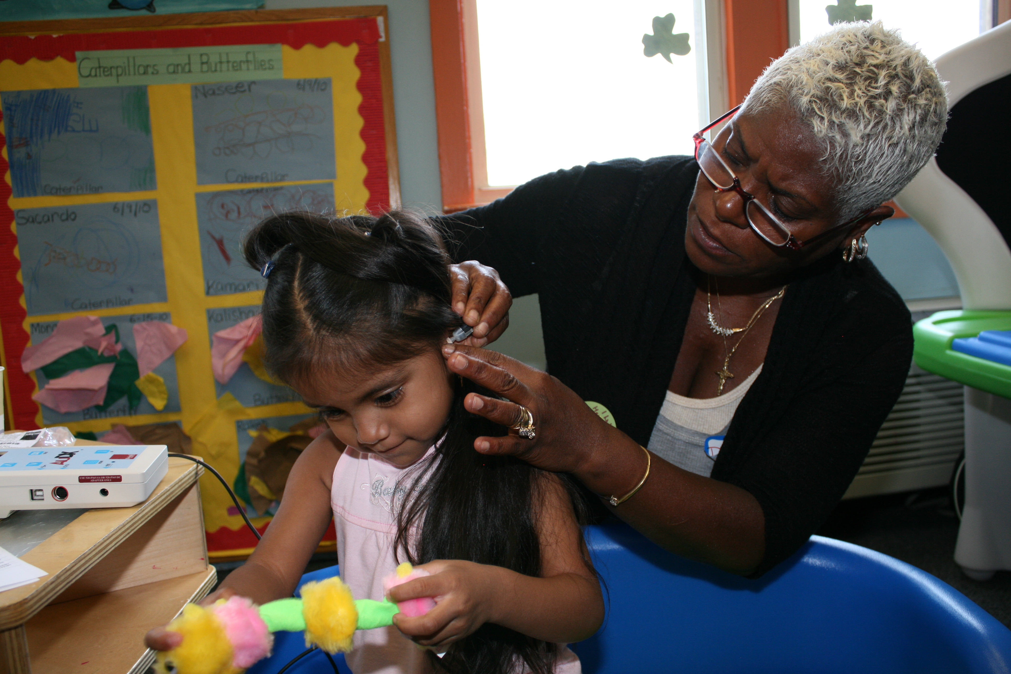
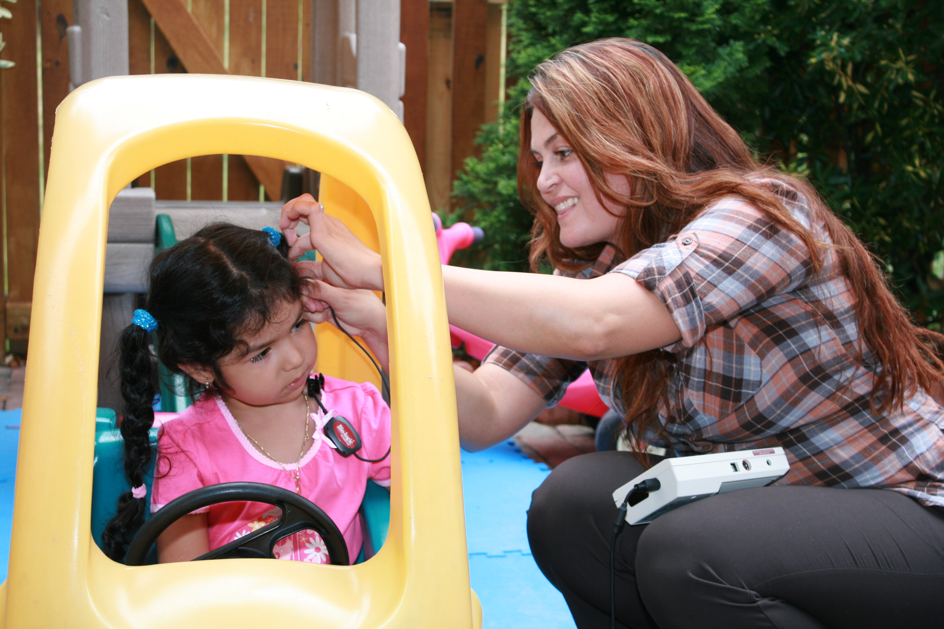
Otoacoustic Emissions (OAE) Screening
Notes:
The short answer to that question is that professionals who are serving children 0 – 3 years of age can learn to conduct Otoacoustic Emissions (OAE) screening in a variety of environments.
“These children are being screened using the OAE method.
They are being screened in educational, home and health care environments.
Those doing the screening are teachers, home visitors, health specialists or medical assistants.

Slide 5
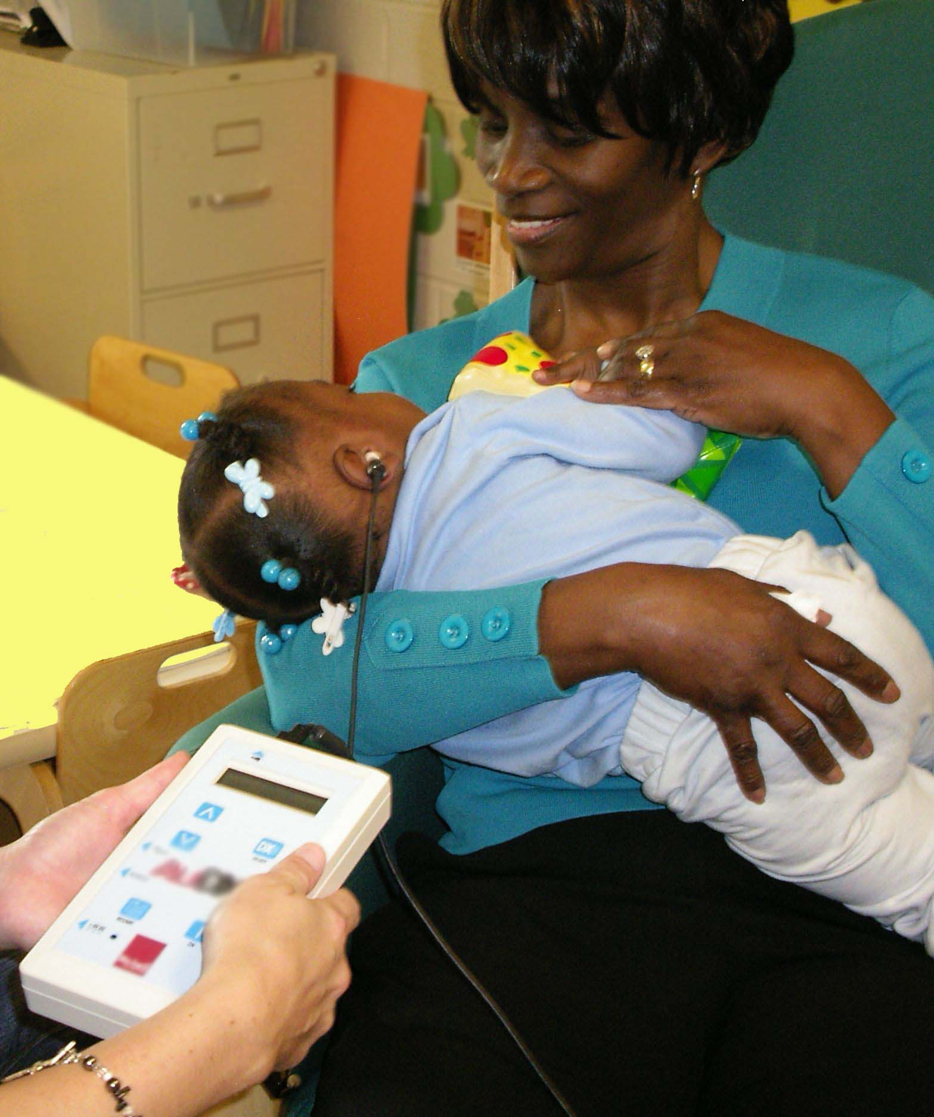
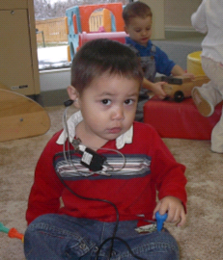
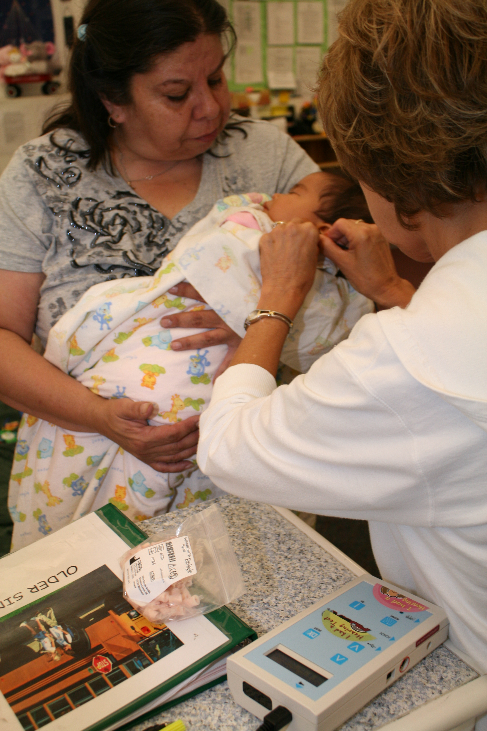
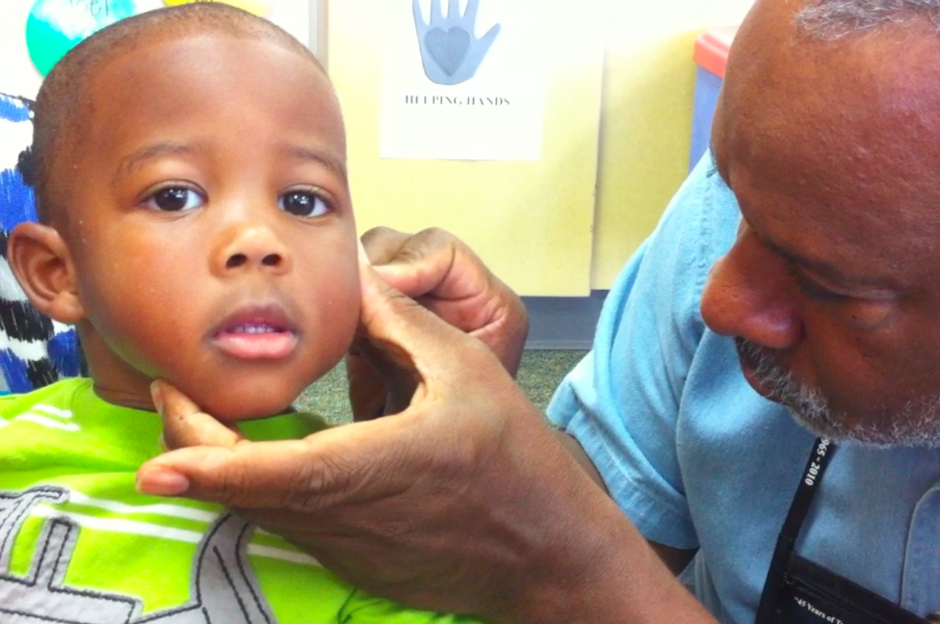
Notes:
The screening works best when children are familiar and comfortable with the adult doing the screening and where they can play with a toy, be held, or even sleep while the screening is conducted.

Slide 6
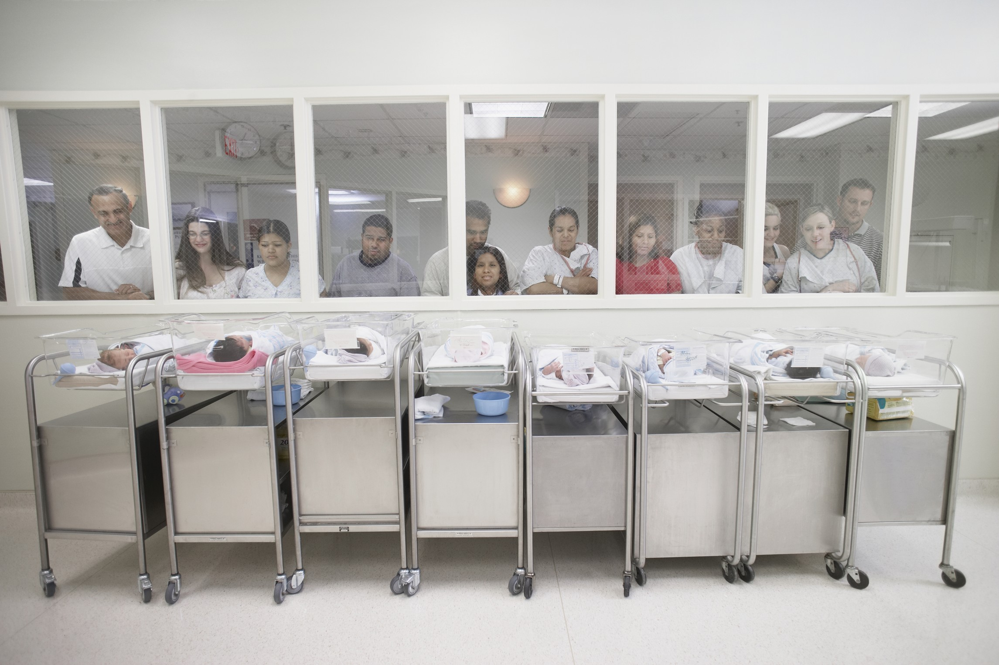
Notes:
Let’s talk about why periodic screening throughout early childhood is important, starting at birth. And why we are seeing more programs, like the one you are a part of adopting OAE screening.
As close as we might look, we can’t see a hearing loss.
Permanent hearing loss is the most common birth defect in the U.S.

Slide 7
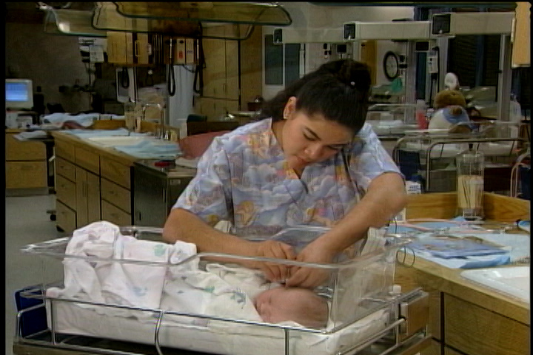
Notes:
Most newborns are now screened for hearing loss, but not every baby gets this screening.

Slide 8
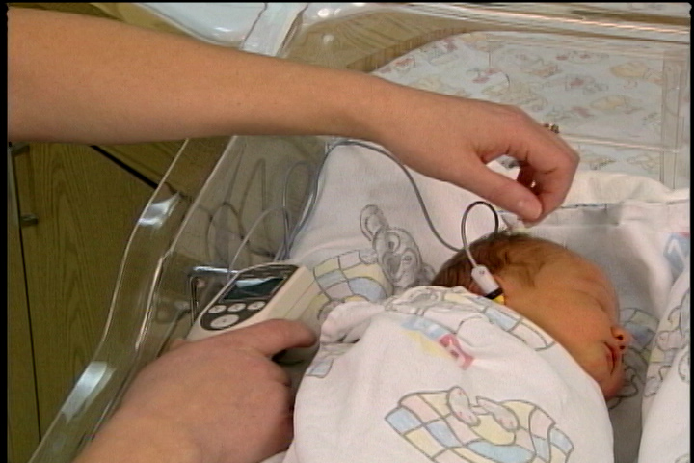
Notes:
Babies not passing the screening require further evaluation, but some are lost to follow- up and don't receive it.

Slide 9
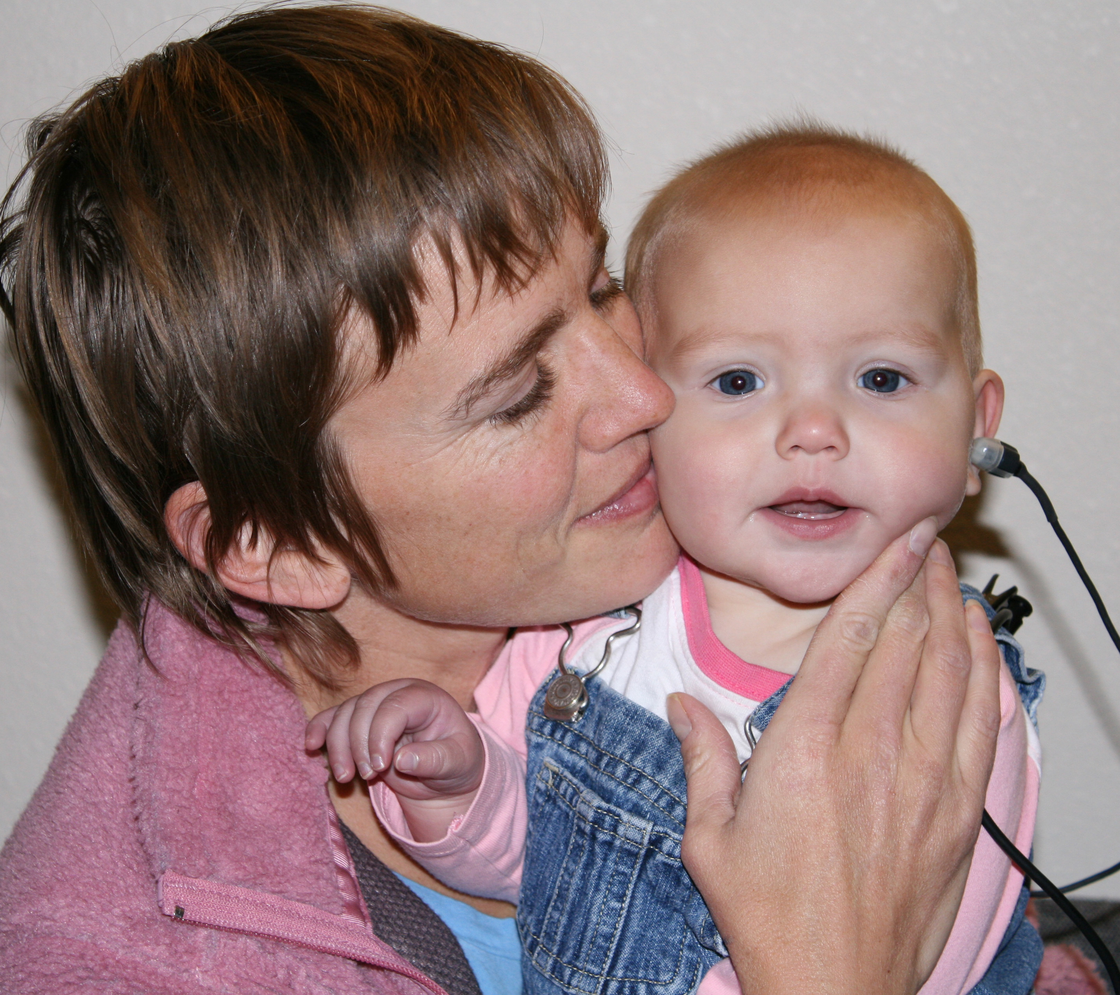
Periodic Screening is needed because:
Not every baby is screened at birth
Some babies are lost to follow-up after screening
Notes:
These are two of the reasons why periodic screening throughout early childhood is needed. But there’s more…

Slide 10
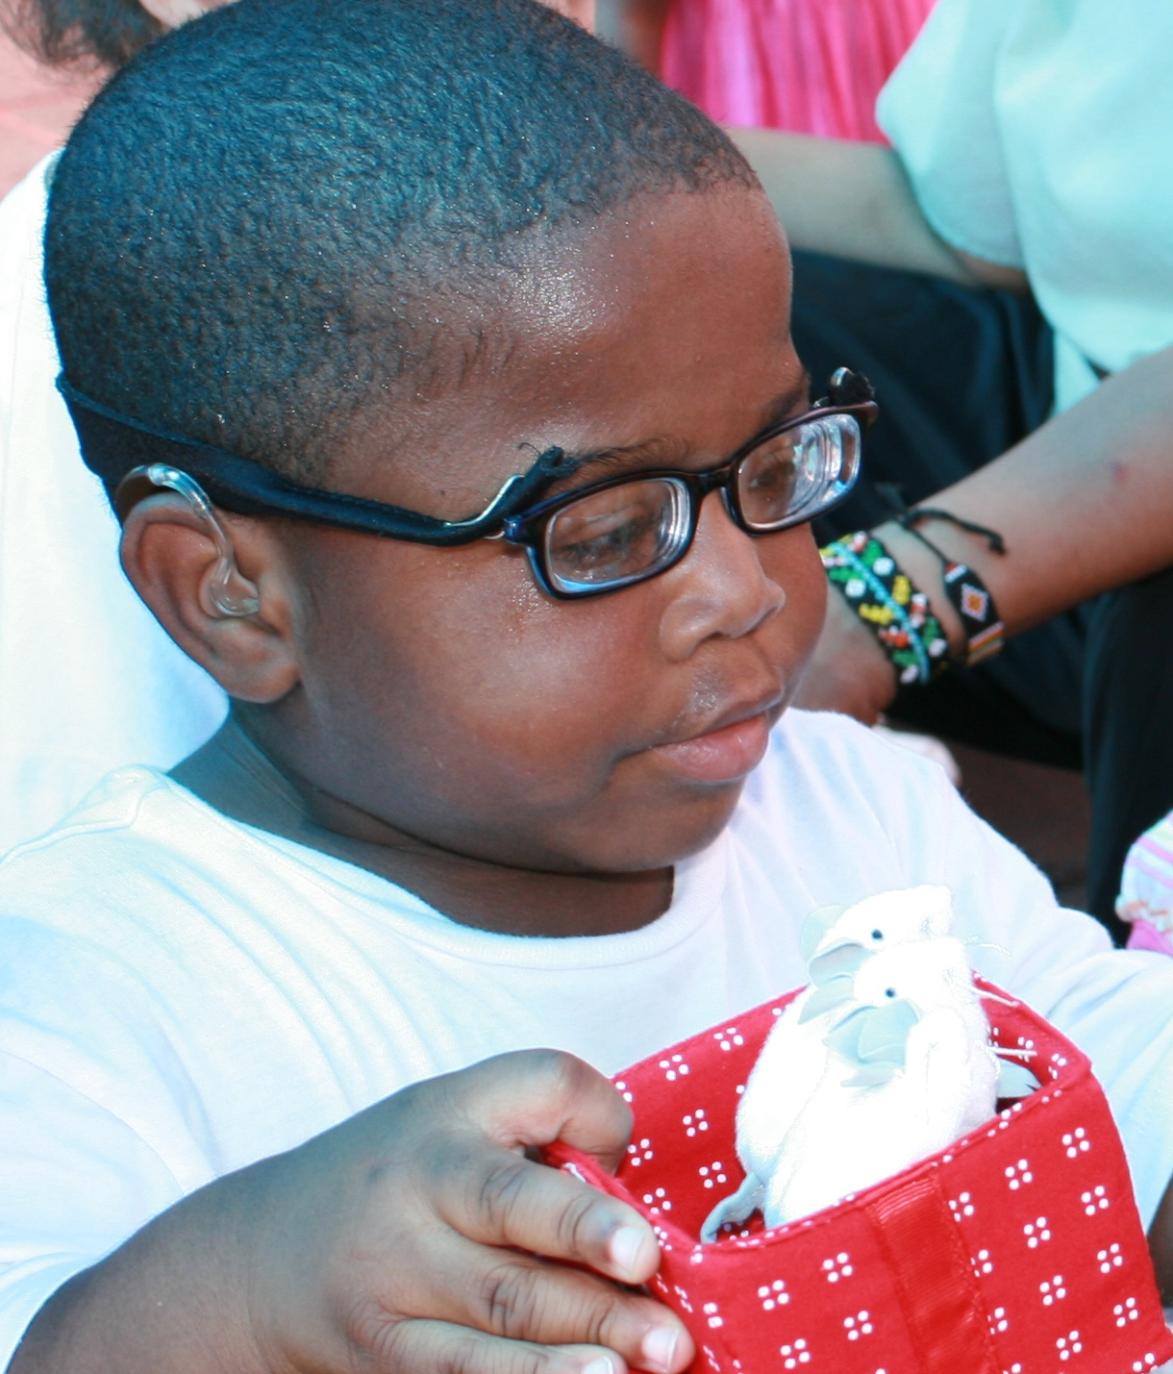
Periodic Screening is needed because:
Hearing loss can occur at any time as a result of
    Illness
    Physical trauma
    Environmental factors
    Genetic factors
Notes:
Even when babies pass the newborn hearing screening, it is important to continue to screen throughout early childhood because...
Hearing loss can occur at any time in a child’s life as a result of illness, physical trauma, or environmental or genetic factors. We will talk a bit more about these causes in a moment.

Slide 11
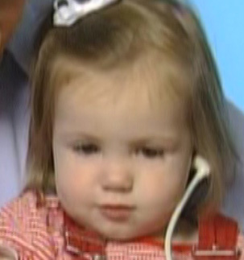
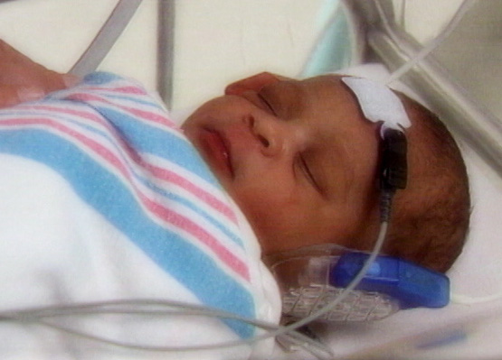
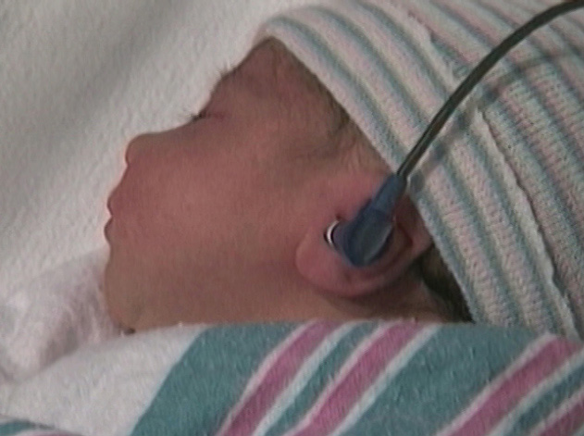
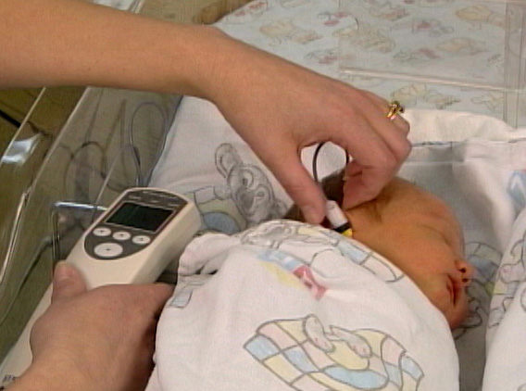
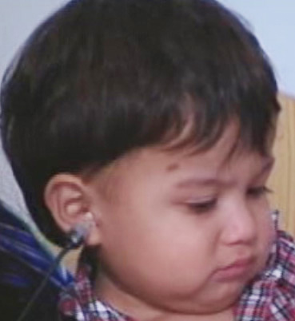
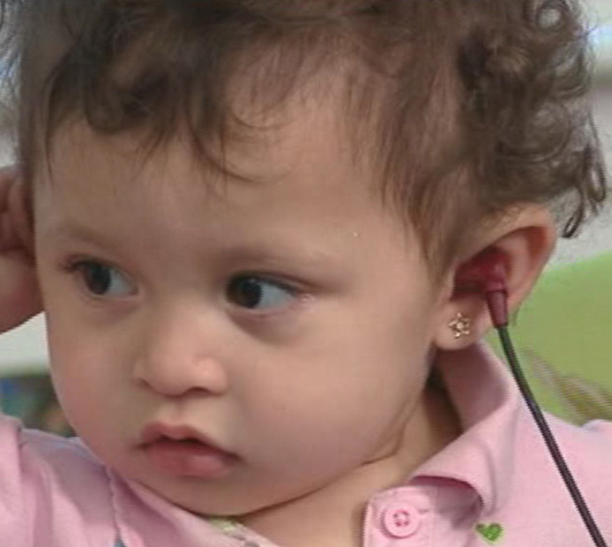
Incidence of permanent
hearing loss doubles
Between birth and school age
Notes:
Research suggests that the incidence of permanent hearing loss doubles between birth and school age, from about 3 children in 1,000 at birth, to about 6 in a thousand by the time children enter school.
That’s why screening during this vulnerable period in a child’s life is so important.

Slide 12



Cognitive development
Social-Emotional
Development
Language Development
Hearing Health
School Readiness
Notes:
Fortunately, there is an increasing awareness on behalf of professionals (whether educational or health care profresionsals as well as among parents of the important of monitoring language development There is a growing understanding that Language development is at the heart of cognitive & social-emotional development and school readiness. We are always encouraging an awareness that Hearing health is at the heart of typical language development. And that means that if we are going to be conscientious about monitoring language throughout early childhood we should be equally conscientious about monitoring hearing statue throughout this critical period as well.

Slide 13
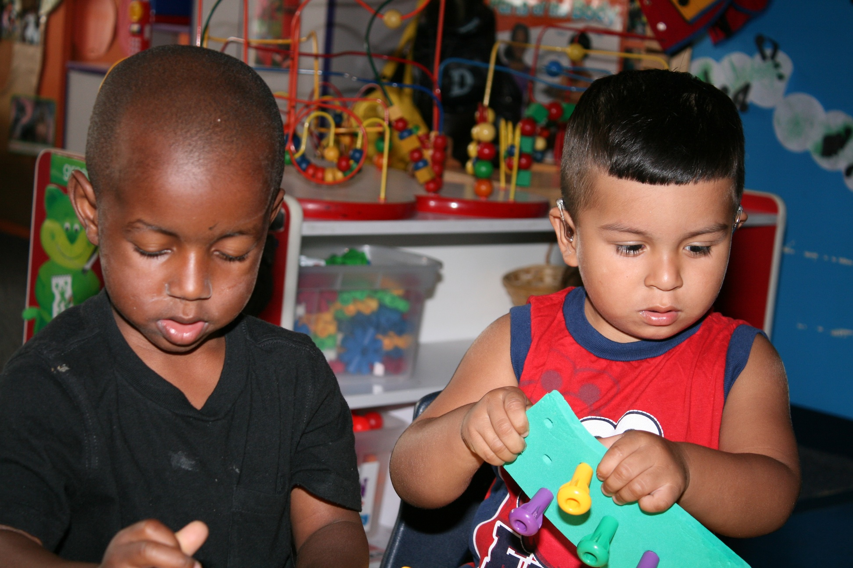
Notes:
Because, we know that hearing Screening, followed by appropriate audiological assessment and early intervention when needed, can dramatically improve options and outcomes for children who are deaf or hard of hearing.

Slide 14
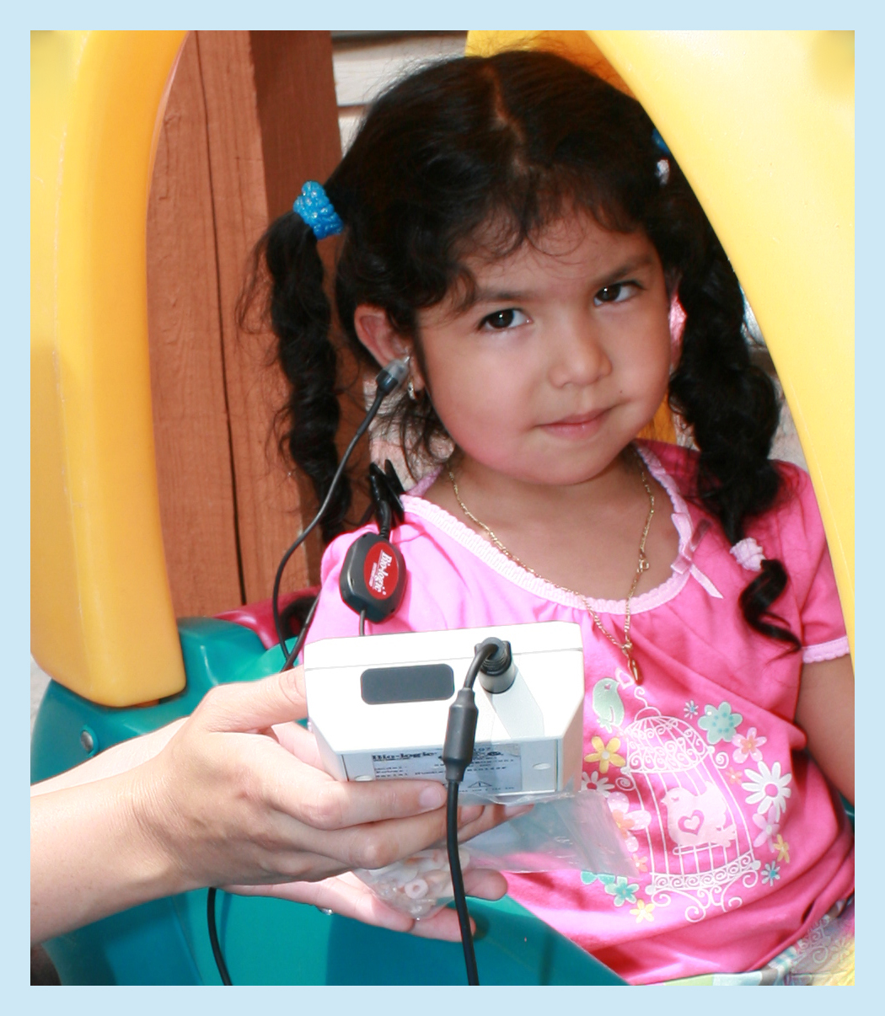

OAE screening for children birth to three years of age:
Accurate & Feasible
Quick & Easy
Flexible
Effective
Notes:
Now let’s talk vor just a moment about why OAE screening is the recommended method for children birth to three years of ago..
OAE screening is the most appropriate method to identify young children at risk for permanent hearing loss because it is:
Accurate
Feasible--does not require a behavioral response from the child, thus allowing us to screen children under three years of age
Quick & easy—most children can be screened in just a minute or two—sometimes in as little as 30 seconds per ear.
Its a flexible tool that can be used in a variety of environments, including classroom, home, or health care settings.
And its effective in identifying children who may have a mild hearing loss, or a loss in just one ear, as well as those who have a severe, bilateral loss. In addition, it can be helpful in drawing attention to a broader range of hearing-health conditions that may need further medical attention.

Slide 15
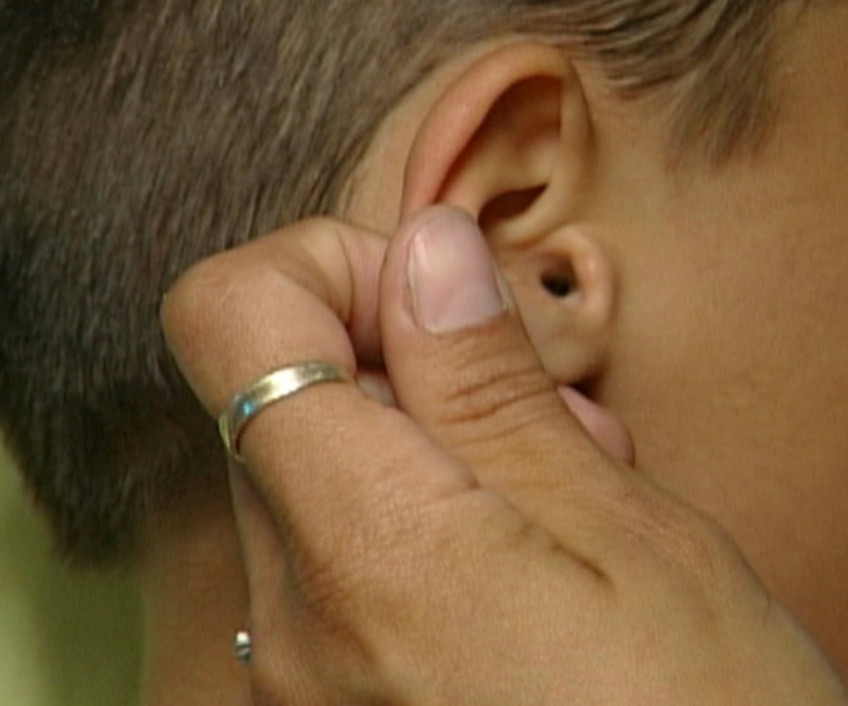
OAE Screening Procedure
Notes:
Here’s a quick overview of the otoacoustic emissions screening process that you have an understanding of how it works
To conduct an OAE screening, we first take a thorough look at the outer part of the ear to make sure there is no visible sign of infection, blockage, or any malformations. <CLICK>

Slide 16
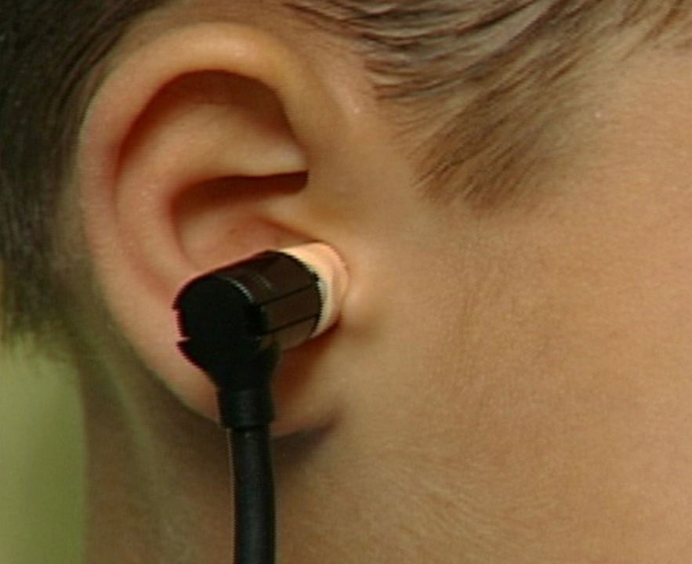
OAE Screening Procedure
Notes:
The OAE screening procedure is completed with the use of a small hand-held device from which a cord extends to a small bud-like probe.
If the visual inspection is ok, the small probe is then placed in the ear canal. <CLICK>

Slide 17
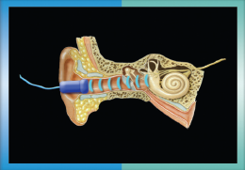
Notes:
The probe, which is illustrated here as the blue object in the outer part of the ear, delivers a low-volume sound stimulus into the ear.
If the cochlea, which is the snail shaped portion of the inner ear that you see on the right, is functioning normally, it will respond to this sound by sending the signal to the brain, while also producing an “acoustic emission” <CLICK>, a sound that travels back out of the ear. This emission is analyzed by the screening unit and in approximately 30 seconds, …<CLICK>

Slide 18
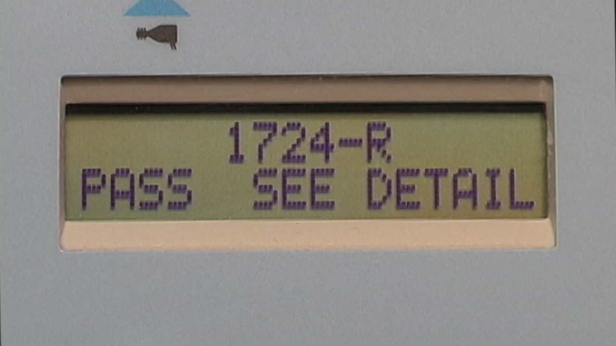
Notes:
A result is displayed on the equipment screen as a pass…<CLICK>

Slide 19
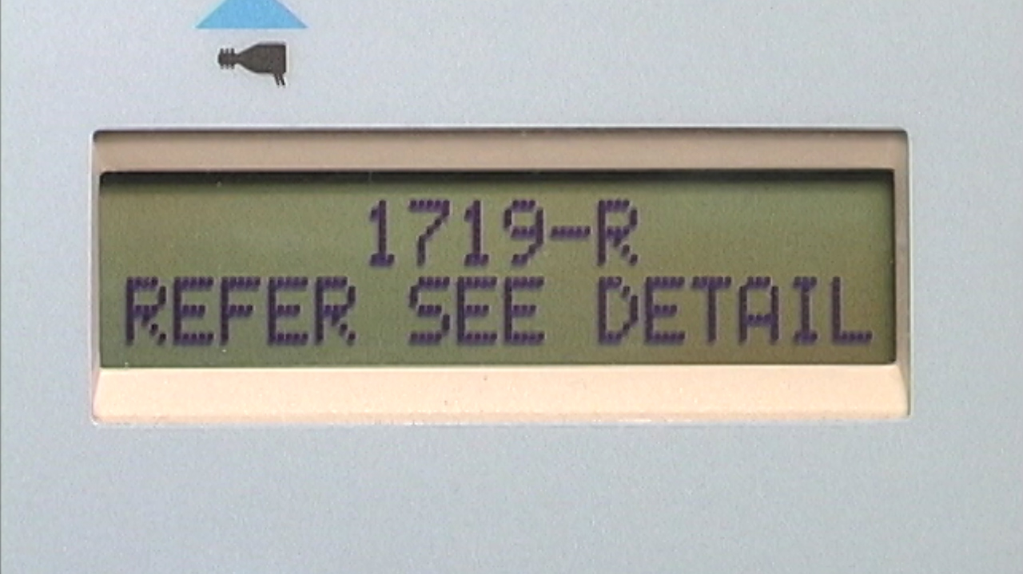
Notes:
…or a refer <CLICK>.

Slide 20
Snapshot of Implementing the OAE protocol
100%
Receive initial OAE screening
Won’t pass 1st OAE. These children must receive a 2nd OAE screening within 2 weeks of initial screening
25%
Won’t pass 2nd OAE.
These children must:
8%
1) be referred to health care provider for middle ear evaluation ASAP
2) receive 3rd OAE screening after health care provider clearance
Won’t pass 3rd OAE. These children MUST be referred to audiologist ASAP for complete diagnostic evaluation – VERY IMPORTANT
<1%
Notes:
When a child doesn’t pass the initial OAE screening on one or both ears, follow-up steps will be necessary. Here’s a quick snapshot of the OAE screening and follow-up protocol. Its helpful at this point just to have a general sense of what the overall follow-up will look like and what percentage of children you will be needing follow-up steps.
100% of your children will receive an initial OAE screening on both ears. We expect that about 75% of children will pass on both ears and will not need any further follow-up; however about 25% will not pass on one or both ears and will need a second OAE screening within 2 weeks. About 8% of the total number of children screened will not pass the second OAE screening and will need to be referred to a health care provider for a middle ear evaluation. Once any middle ear problems have been resolved and medical clearance has been given, you will then screen this small number of children a 3rd time. We expect that less than 1% of the total number of children being screened will not pass the 3rd OAE screening and will be referred to a pediatric audiologist for a complete audiological evaluation. So although a small subset of children will indeed need follow-up referral and further OAE screening, it is a feasible protocol that helps children get the medical and audiological attention they need while minimizing unnecessary referrals to health care providers.

Slide 21

What are the most common causes of late-onset hearing loss?
Acquired
Structural
Genetic
Notes:
1. Acquired – Head trauma, pathological (disease), noise exposure
2. Structural – structural irregularities that might interfere with hearing – stenosis, Mondin dysplasia etc.
3. Genetic – hereditary – syndrome, family history etc.

Slide 22
Acquired Late-Onset Hearing Loss
Congenital Cytomegalovirus (CMV)
Other Childhood Illnesses
Traumatic late-onset hearing loss
Ototoxic medications
Notes:
The availability of OAE screening means that it is no longer appropriate to rely on subjective methods…

Slide 23
Structural Late-Onset Hearing Loss
Structural deformities or malformations of the cochlea
  Congenital but not always syndromic
    Large Vestibular Aqueduct (LVA)
    Mondi malformation
  Large variation in when hearing loss may occur
  Associated with sudden and extreme progression
  and fluctuation
Notes:
Structural:
Structural causes of late-onset hearing loss may occur with a number of syndromes. Structural deformities of the cochlea such as LVA and Mondini malformation are congenital but not always related to a specific syndrome.
Cochlear malformations affect hearing differently in different children. Some hearing losses may occur earlier and others may not present until later childhood.
Structural malformations of the inner ear are associated with sudden and extreme progression and fluctuation of hearing.

Slide 24
Genetic Late-Onset Hearing Loss
Syndromic
  Prendred
  Alports
  Usher
2. Non-syndromic
  Dominant progressive hearing loss
  Family history of late occurring hearing loss
  Connexin 26
Notes:
Genetic:
Genetic causes of late-onset hearing loss may be syndromic or non-syndromic..
Syndromic losses include:
Pendred’s Syndrome, which is associated with LVA
Branchio-Oto-Renal Syndrome (BOR), associated with Mondini deformities
Alports Syndrome with progressive renal failure and late occurring, progressive hearing loss
Stickler Syndrome, a connective tissue syndrome with late occurring vision problems and hearing loss
Usher Syndrome with progressive blindness and deafness. Usher Type I is associated with more severe hearing loss, lack of vestibular function and blindness. Types II and III typically show less severe hearing loss, less severe vestibular effects and more residual vision, with Type III occurring rarely
Neurofibromatosis Type II with progressive hearing loss resulting from auditory nerve tumors
Other neurodegenerative syndromes may be associated with late onset hearing loss, but are not as common as the syndromes listed above (e.g. Refsum Disease)
Non-syndromic losses include:
Dominant-progressive hearing loss
Family history of late-occurring hearing loss
Connexin 26, which may have late-onset hearing loss in rare occurrences. A small number of studies have shown progressive hearing loss with Connexin 26

Slide 25
Risk Factors Associated with Late-Onset Hearing Loss
Congenital CMV infection
Meningitis or mumps infections
Family history of late-onset hearing loss
Syndromes associated with late-onset hearing loss
Head trauma, especially with basal or temporal bone fracture
Chemotherapy, especially when administered in conjunction with radiation
Notes:
To summarize – across the acquired, structural and genetic catagories – these are the main risk factors to be concerned about:
Congenital CMV infection
Meningitis or mumps infections
Family history of late-onset hearing loss
Syndromes associated with late-onset hearing loss
Head trauma, especially with basal or temporal bone fracture
Chemotherapy, especially when administered in conjunction with radiation

Slide 26
Monitoring For Late-Onset Hearing Loss
Know | Action | How
Determine risk factors for late on-set HL including parent concern | Screen hearing if risk factors present | In office or refer for screening
Baseline hearing for each child | Use newborn or early childhood screening results | Obtain NHS results from screening hospital Obtain a current early childhood hearing screen if done elsewhere In office or through referral
How to support early childhood hearing screening programs | Provide timely middle ear assessment when referrals are made Communicate results and treatment plan to referring programs Assist in making audiological referrals when needed | Learn local resources for screening Communicate back to programs in a timely manner Work with programs for appropriate referrals
* Using Otoacoustic Emissions to Screen Young Children for Hearing Loss in Primary Care Settings, T Foust, W. Eiserman, L. Shisler, A. Geroso. Pediatrics 2013, 132, 118.

Slide 27
Check out online tools…
Find local audiologists
Audiologist’s Guide
www.kidshearing.org/getstarted
Notes:
Check our tools on kidshearing.org about how to find a pediatric audiologist near you and the guide that was written to help them know how best to help you.
One of the things you’ll want to do with your partner audiologist is to visit kidshearing.org and work though it together.
William, back to you…<CLICK>

Slide 28
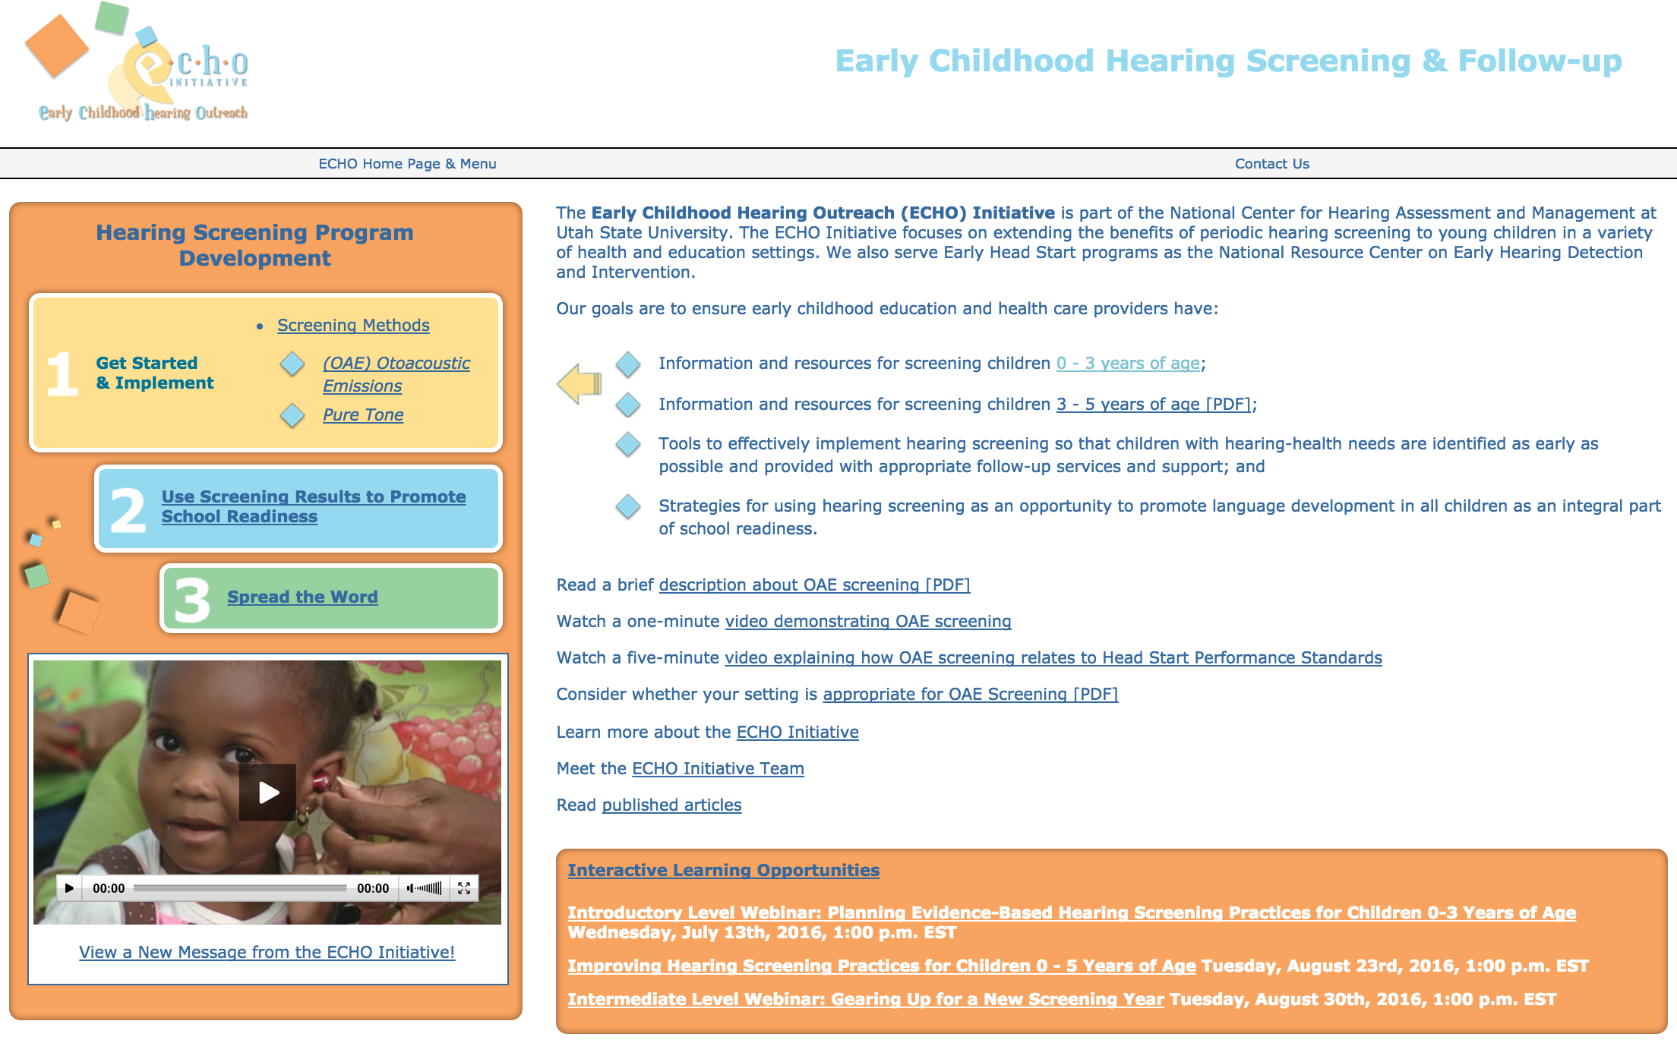

Slide 29
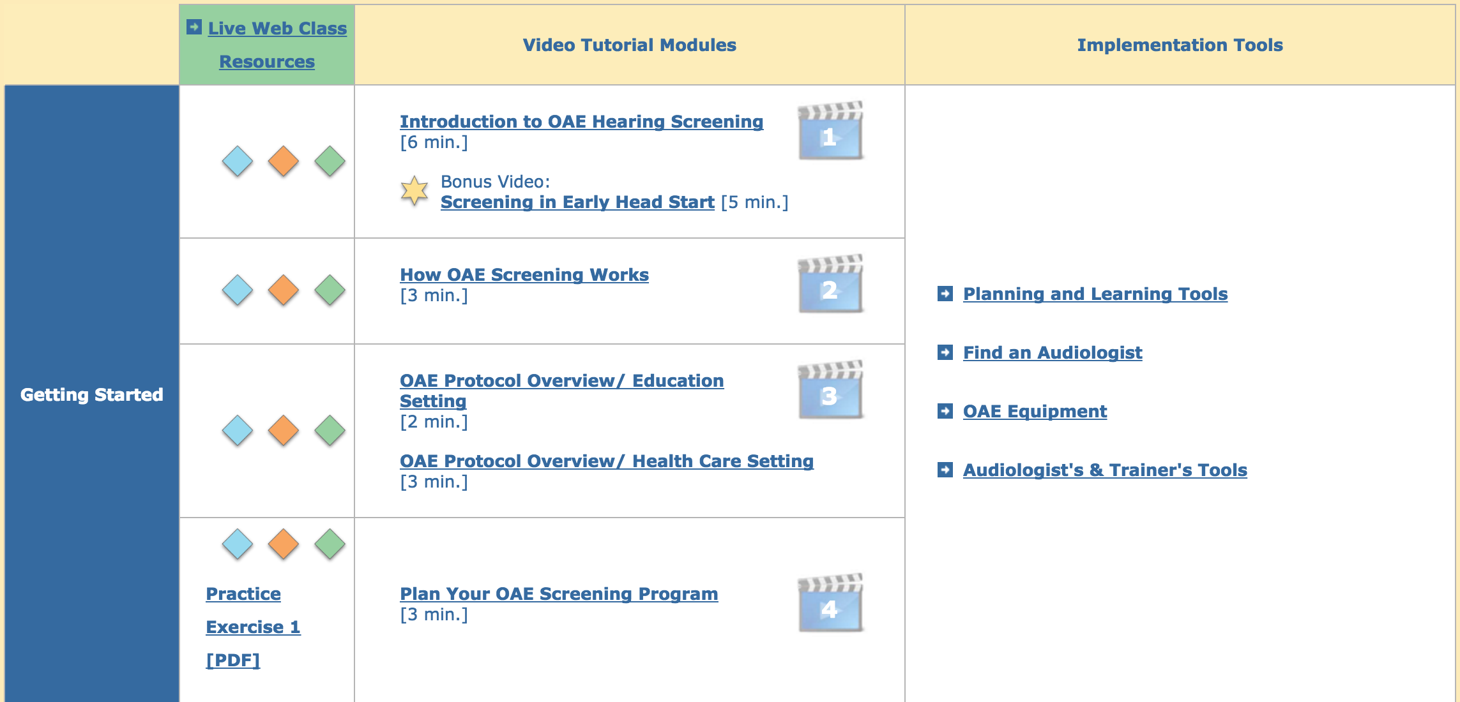

Slide 30
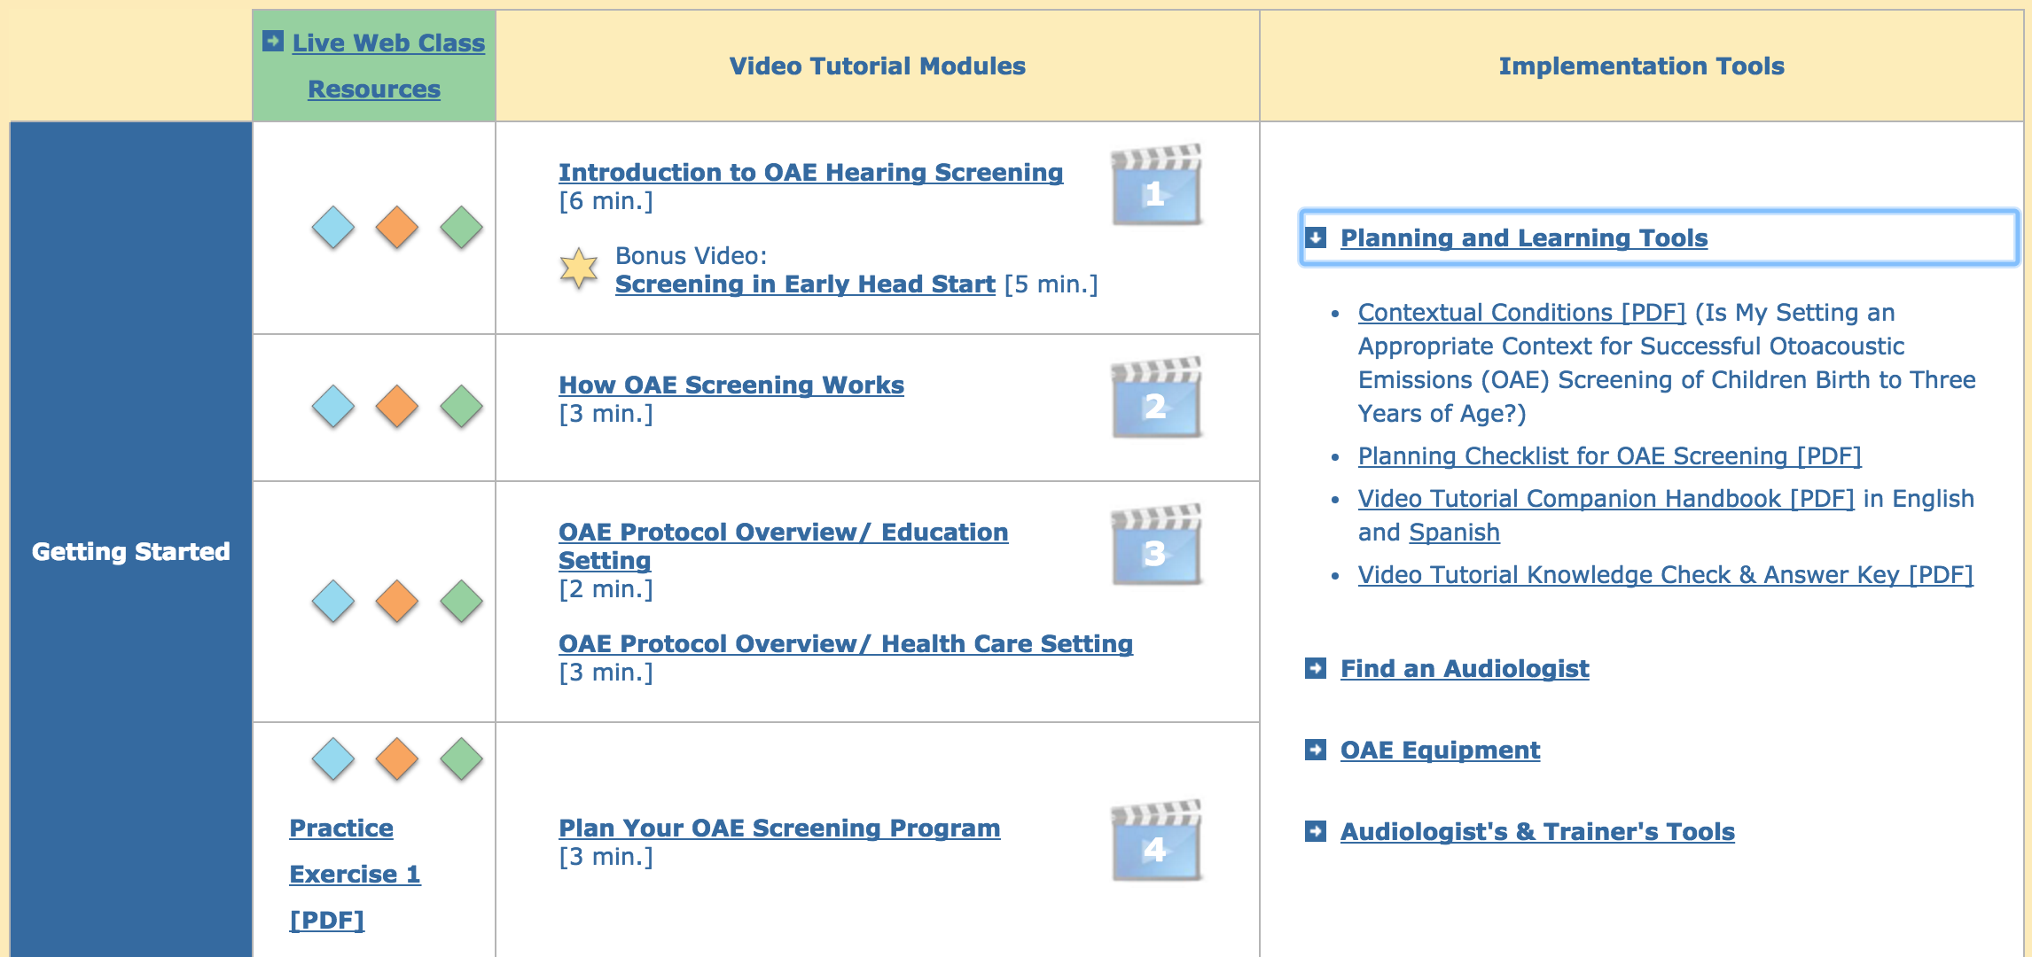

Slide 31
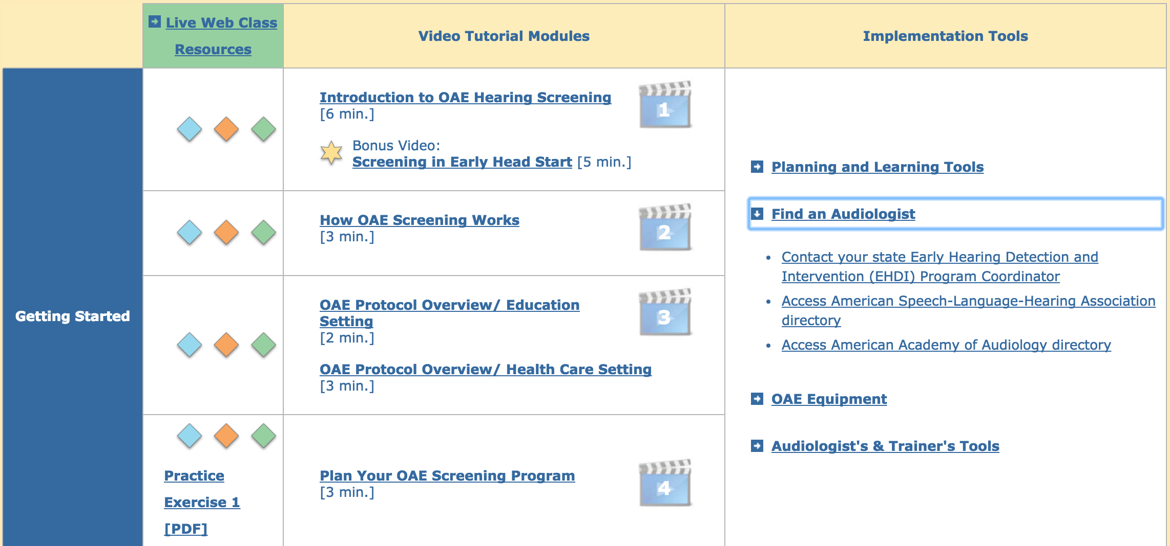

Slide 32
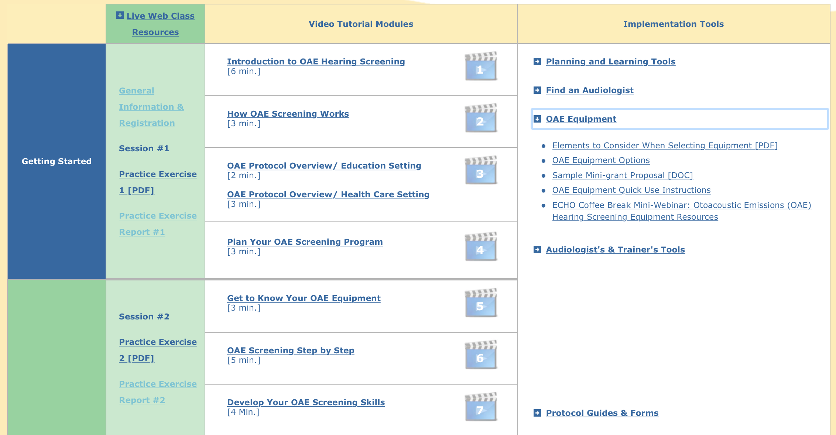
Notes:
Today we are also going to refer you to a short video you will need to watch for this sessions practice exercise. This is a brand specific video of about 8-10 min long that will give you important details about using your equipment. You’ll we instructed in the practice exercise to watch this before attempting to screen yourself or others. So, please remember to do this. These brand specific videos are found here on kidshearing.org

Slide 33
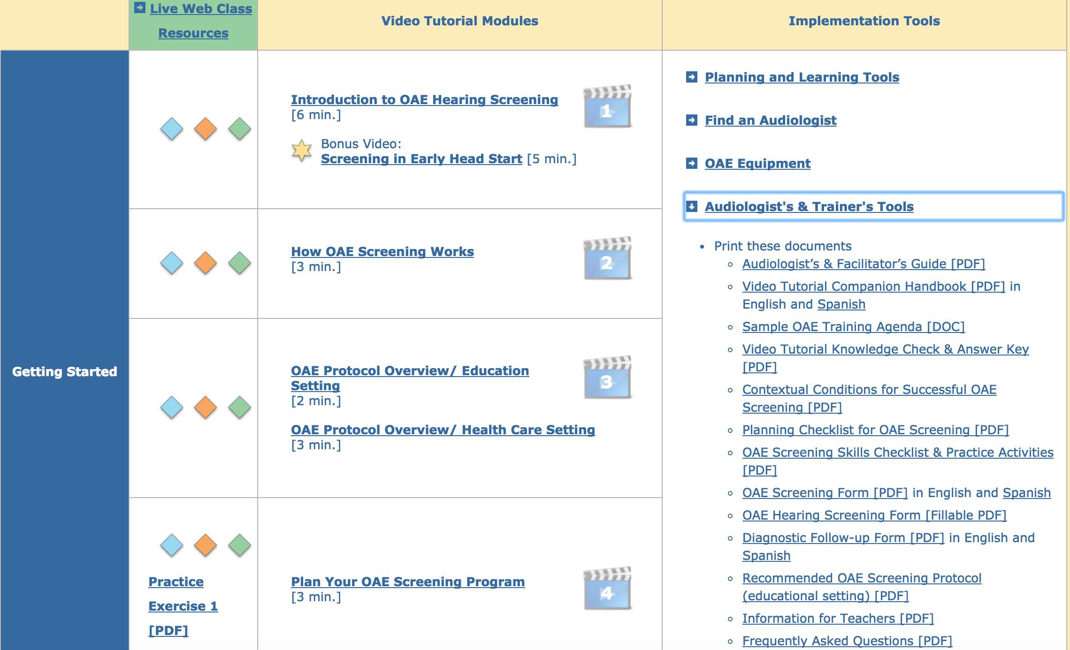

Slide 34
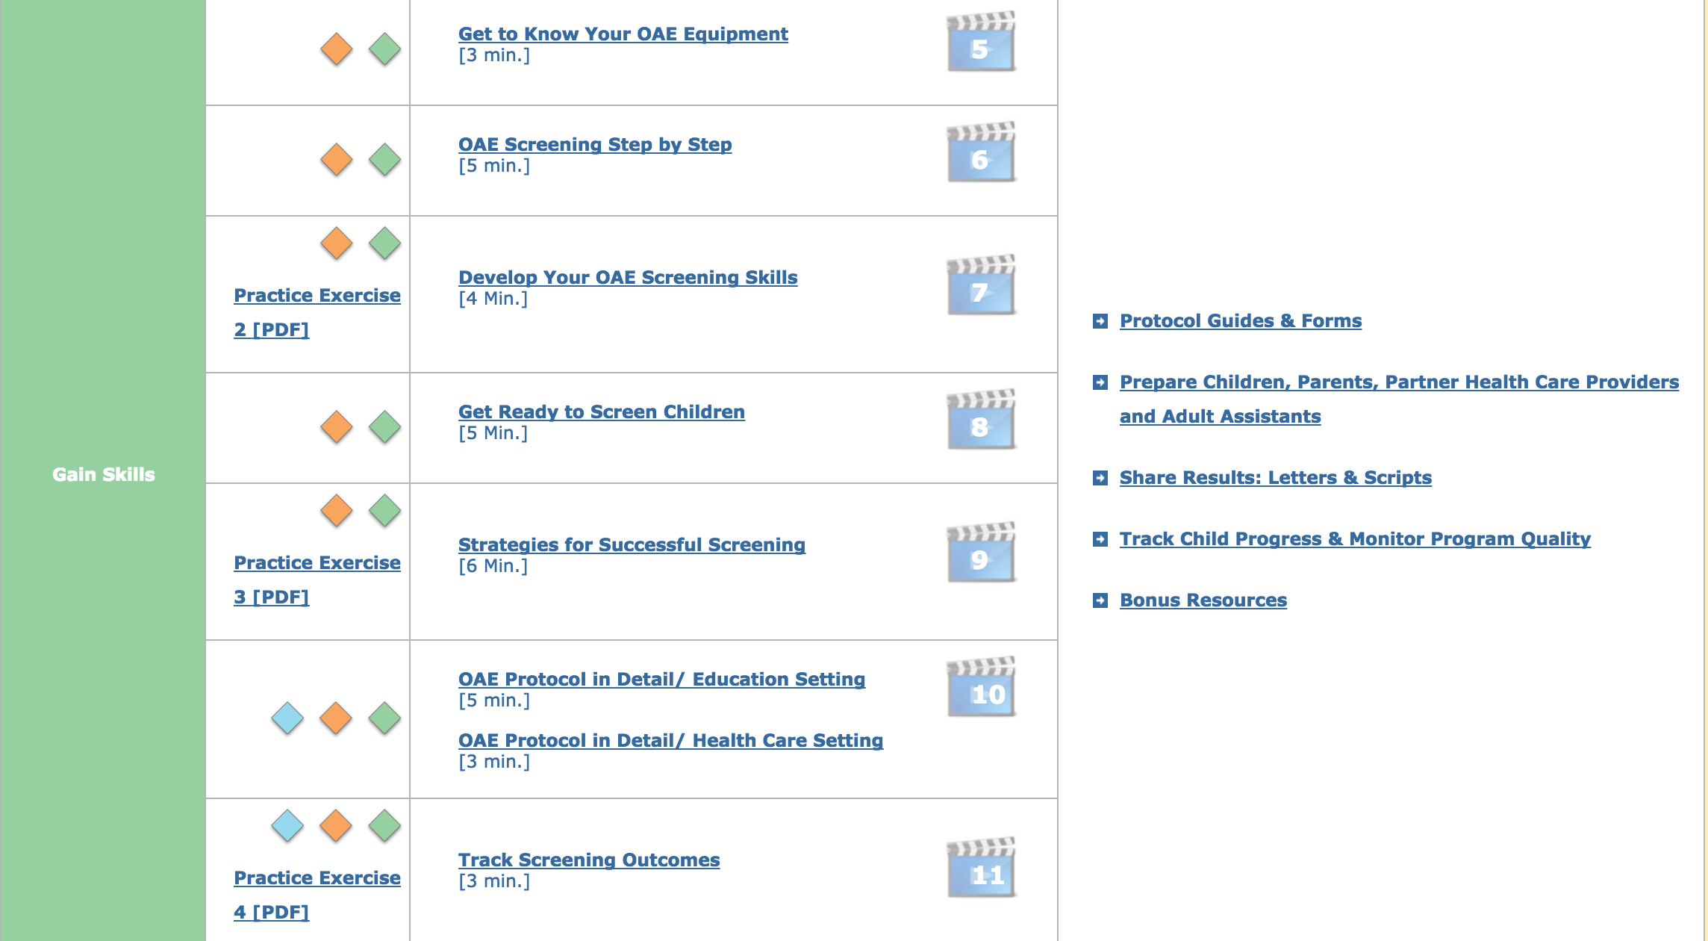

Slide 35
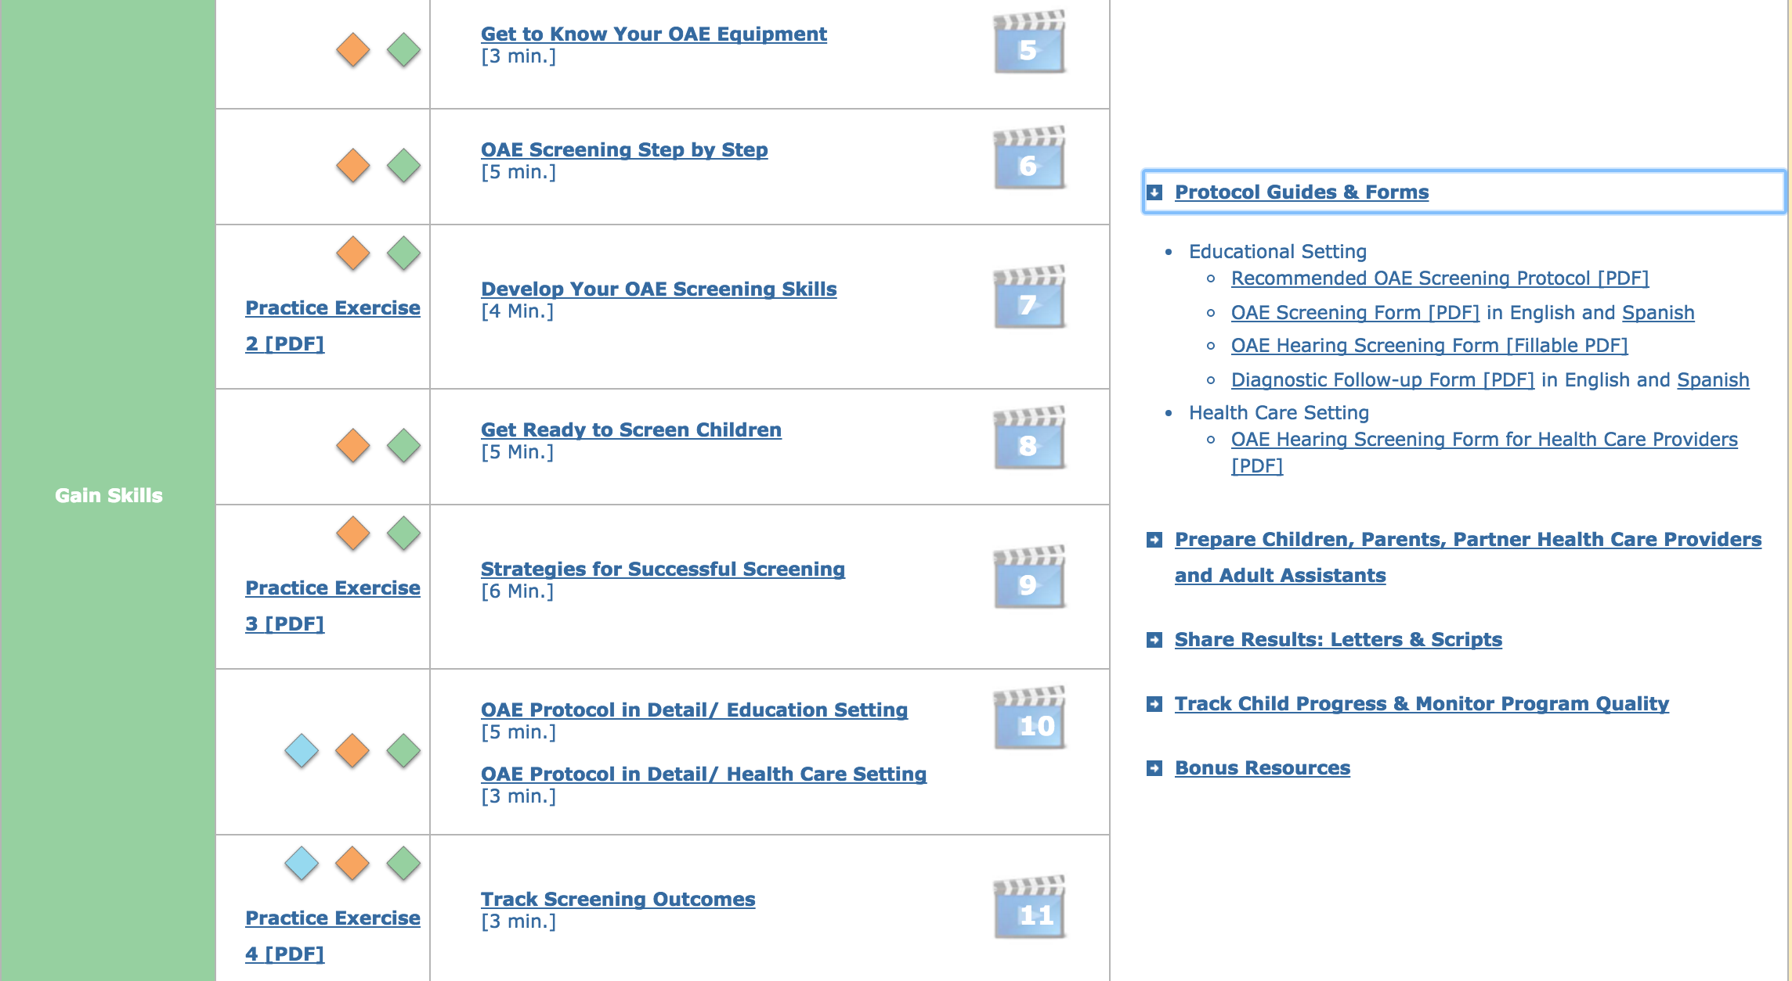

Slide 36
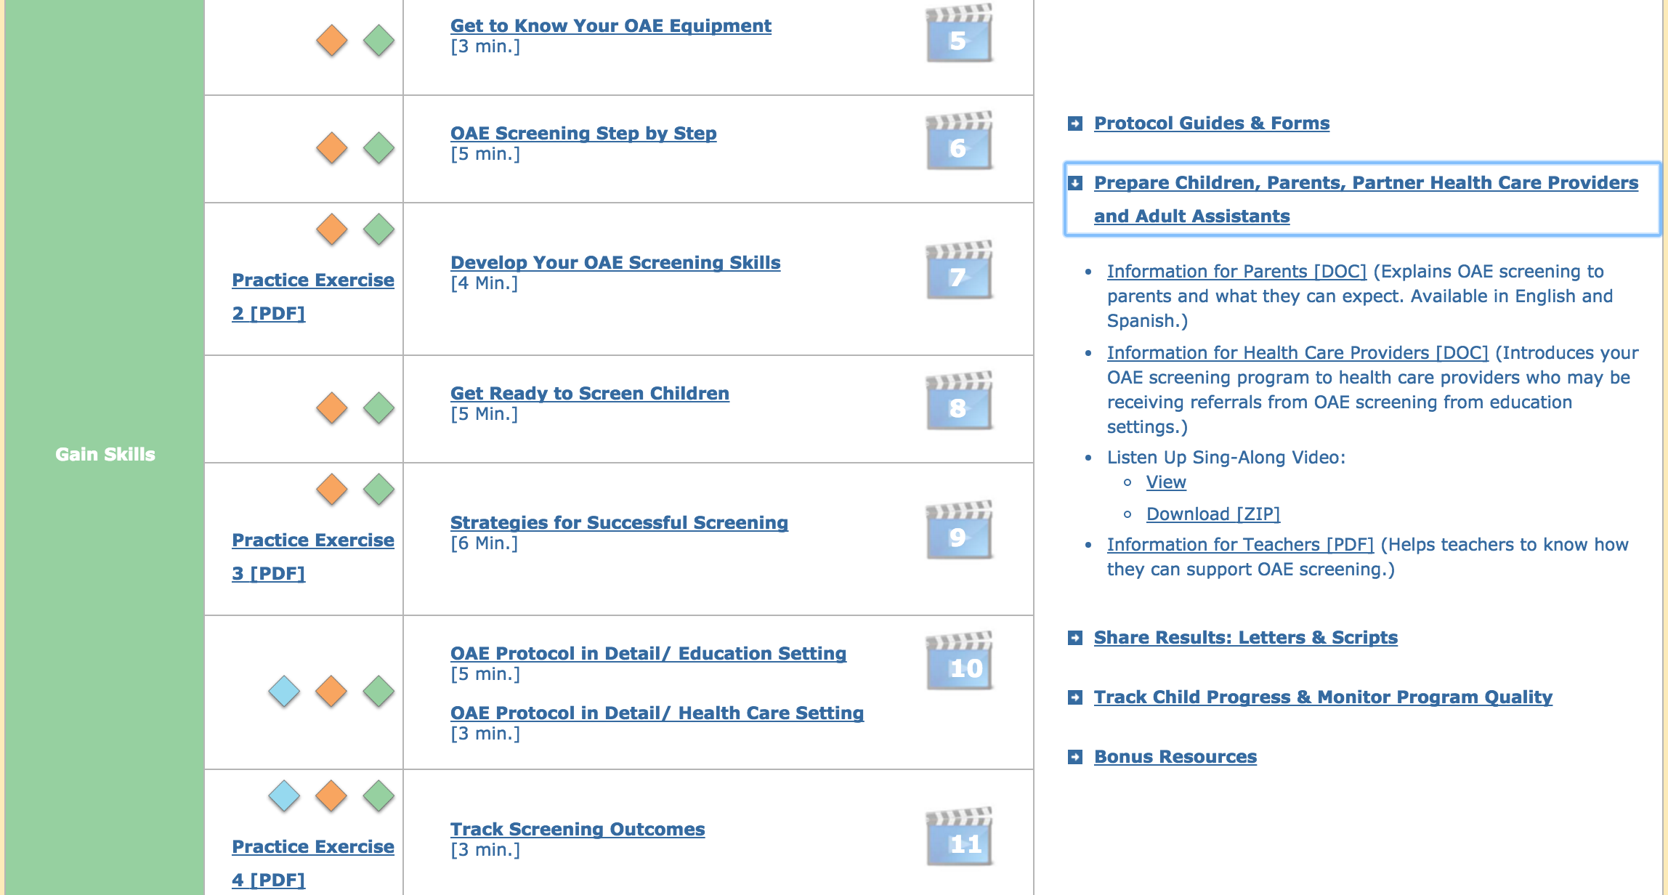

Slide 37
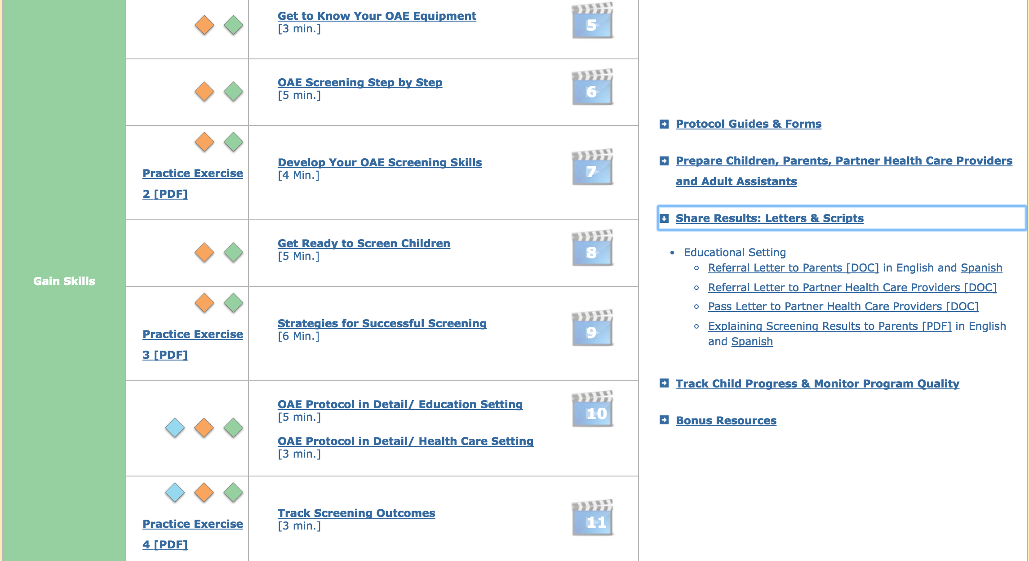

Slide 38
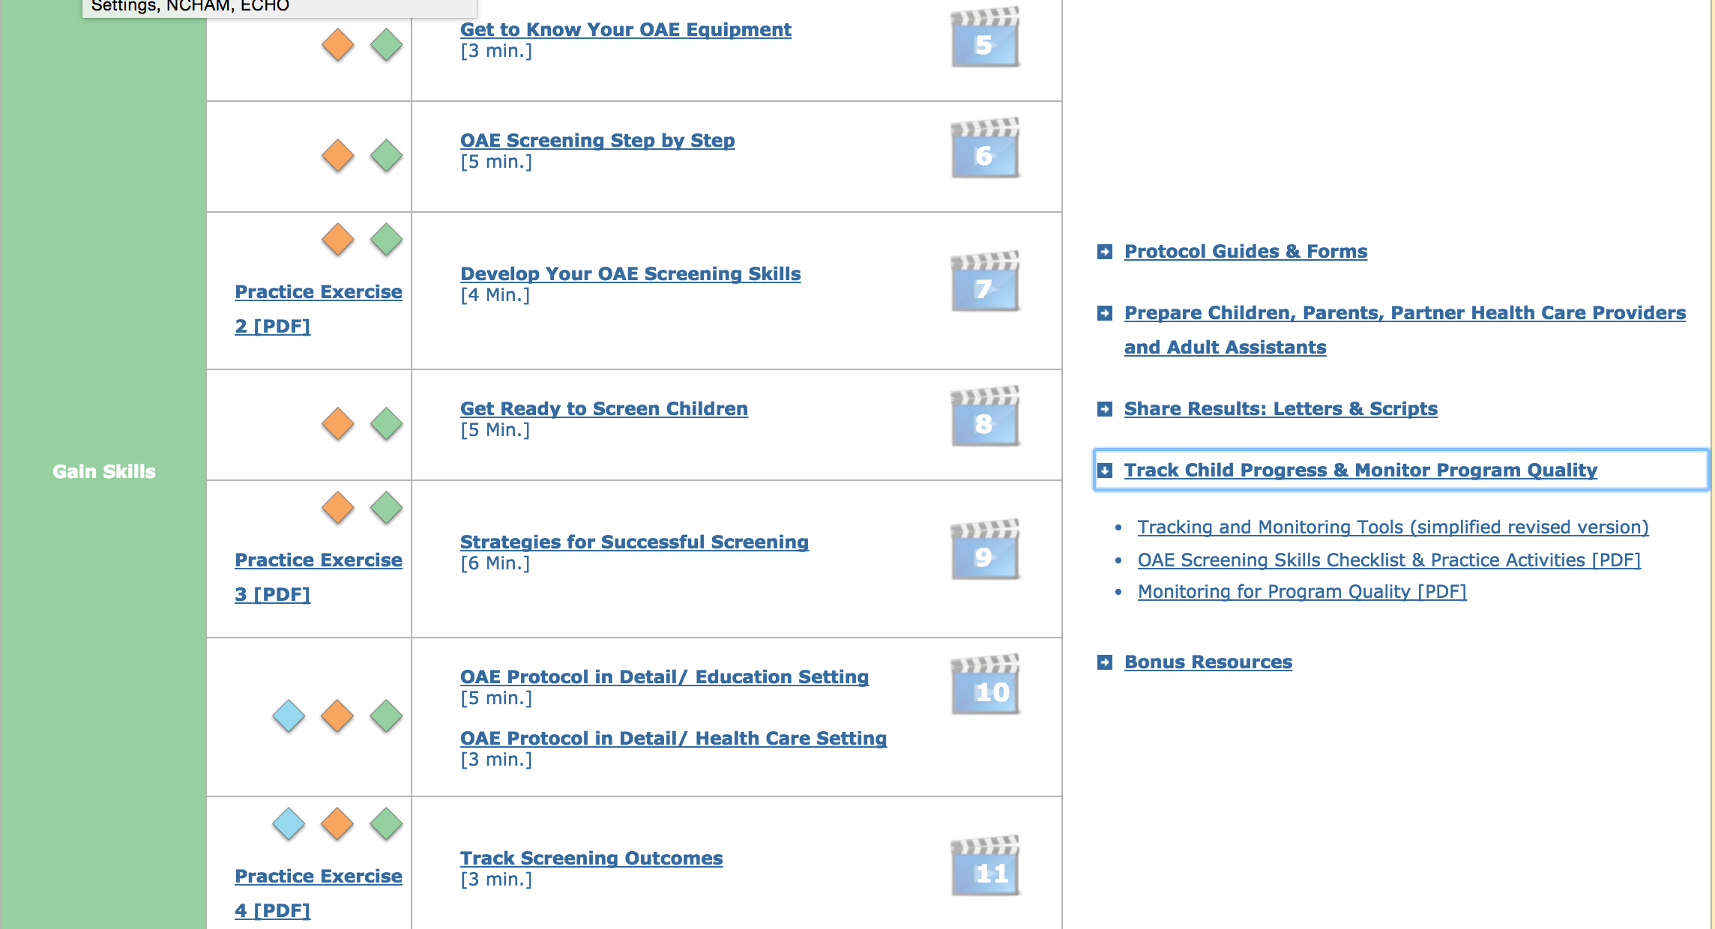

Slide 39
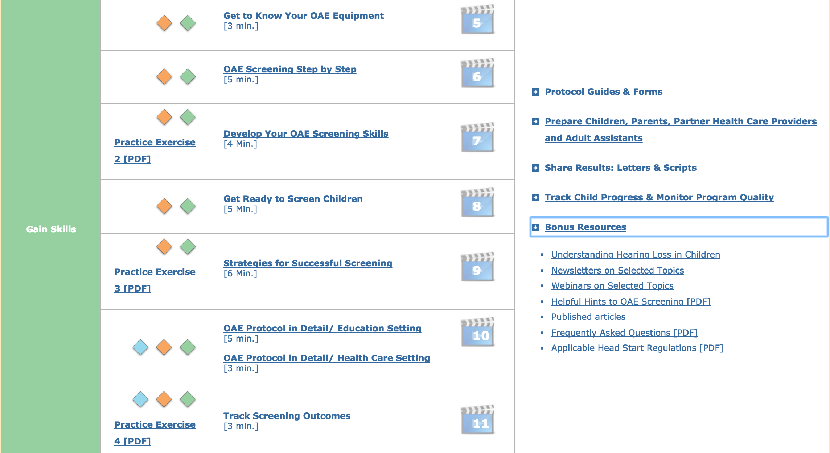

Slide 40
